Slide 1
CSC 455: Database Processing for Large-Scale Analytics
Lecture 7
Alexander Rasin
College of CDM, DePaul University
November 5th, 2013

Slide 2
Tonight
Triggers
PL/SQL
Python
  Regular expressions
Reading/saving files
Data transformation

Slide 3
Triggers
Triggers allow general responses to changes in the database state:
  Enforcement of business rules
  Notification of events
  Maintenance of derived information
  Maintenance of replicated data
  Implementation of cross-table constraints

Slide 4
Event-Condition-Action Model
An event causes the trigger to fire
  Before or after an insertion, deletion, or update
A condition is tested to see whether or not the trigger will respond (optional…)
  May depend on original state or modified state
An action may be executed in response
  May be sequence of SQL statements or some stored procedure

Slide 5
Triggers
CREATE OR REPLACE TRIGGER started
BEFORE UPDATE OF started ON student
FOR EACH ROW
WHEN (new.started < old.started)
BEGIN
:new.started := :old.started;
DBMS_OUTPUT.PUT_LINE('Rejected change of started');
END;
/
SET SERVEROUTPUT ON;
UPDATE student
SET Started = 2001;
SELECT * FROM student;

Slide 6
Triggers
Create trigger
CREATE OR REPLACE TRIGGER started
BEFORE UPDATE OF started ON student
FOR EACH ROW
WHEN (new.started < old.started)
BEGIN
:new.started := :old.started;
DBMS_OUTPUT.PUT_LINE('Rejected change of started');
END;
/
triggering event
attribute/table
row trigger
trigger restriction
old: row before update
new: row after update
trigger action
(in PL/SQL)

Slide 7
Triggering Events
CREATE OR REPLACE TRIGGER started
BEFORE UPDATE OF started ON student
FOR EACH ROW
WHEN (new.started < old.started)
BEGIN
:new.started := :old.started;
DBMS_OUTPUT.PUT_LINE('Rejected change of started');
END;
/
When do we trigger:
before
after
instead of
(only for views)
What is doing the triggering:
insert, update, delete
system events

Slide 8
row/statement trigger
WHEN only
for row-level
triggers
CREATE OR REPLACE TRIGGER started
BEFORE UPDATE OF started ON student
FOR EACH ROW
WHEN (new.started < old.started)
BEGIN
:new.started := :old.started;
DBMS_OUTPUT.PUT_LINE('Rejected change of started');
END;
/
:new/:old only
for row-level
triggers
vs
CREATE OR REPLACE TRIGGER started
AFTER UPDATE ON student
BEGIN
DBMS_OUTPUT.PUT_LINE(Student Table updated');
END;
/

Slide 9
Restriction (WHEN)
CREATE OR REPLACE TRIGGER started
BEFORE UPDATE OF started ON student
FOR EACH ROW
WHEN (new.started < old.started)
BEGIN
:new.started := :old.started;
DBMS_OUTPUT.PUT_LINE('Rejected change of started');
END;
/
old
(before change)
new
(after change)

Slide 10
Trigger Action
BEGIN
pl/sql block
END;
/
:old, :new
variables
dbms_output
CREATE OR REPLACE TRIGGER started
BEFORE UPDATE OF started ON student
FOR EACH ROW
WHEN (new.started < old.started)
BEGIN
:new.started := :old.started;
DBMS_OUTPUT.PUT_LINE('Rejected change of started');
END;
/

Slide 11
Example: Logging
CREATE OR REPLACE TRIGGER studentlog
AFTER INSERT OR UPDATE OR DELETE ON student
BEGIN
DBMS_OUTPUT.PUT_LINE('Insert/Delete/Update on Student Table');
END;
/
CREATE OR REPLACE TRIGGER started
AFTER INSERT OR UPDATE OR DELETE ON student
BEGIN
IF UPDATING THEN
DBMS_OUTPUT.PUT_LINE('Update on Student');
ELSIF INSERTING THEN
DBMS_OUTPUT.PUT_LINE('Insert on Student');
ELSIF DELETING THEN
DBMS_OUTPUT.PUT_LINE('Delete on Student');
END IF;
END;
/

Slide 12
Unique ID: Sequences in Oracle
--- create a new sequence for student table
CREATE SEQUENCE SEQ_STUDENT_ID
INCREMENT BY 1
START WITH 1;
--- example application
INSERT INTO student(SID, LastName,FirstName)
VALUES(seq_student_id.nextval, 'Pendleton', 'Gabriela');
--- drop sequence
DROP SEQUENCE seq_student_id;

Slide 13
Using sequence with trigger
--- create a new sequence for student table
CREATE SEQUENCE SEQ_STUDENT_ID
INCREMENT BY 1
START WITH 1;
--- create trigger to insert new ID automatically
CREATE OR REPLACE TRIGGER student_id_trigger
BEFORE INSERT ON student
FOR EACH ROW
BEGIN
SELECT seq_student_id.nextval
INTO :new.SID
FROM dual;
END;
/
Notes:
SHOW ERRORS

Slide 14
Example: Logging into table
CREATE OR REPLACE TRIGGER studentlog
AFTER INSERT ON student
FOR EACH ROW
BEGIN
DBMS_OUTPUT.PUT_LINE('Insert on Student Table');
insert into elog
values(seq_student_id.nextval, :new.SID, 'I', systimestamp);
END;
/
CREATE TABLE elog(
eid NUMBER,
esid NUMBER(5),
etype CHAR,
etime DATE,
PRIMARY KEY(eid)
);

Slide 15
Auto-generated Columns
DROP TABLE TableX;
CREATE TABLE TableX
( UniqueID RAW(16) DEFAULT SYS_GUID() PRIMARY KEY,
Value Varchar2(50)
)
INSERT INTO TableX (Value) VALUES ('Value1');
INSERT INTO TableX (Value) VALUES ('Value2');
INSERT INTO TableX (Value) VALUES ('Value3');

Slide 16
Auto-generated Columns
DROP TABLE TableX;
CREATE TABLE TableX
( UniqueID INTEGER PRIMARY KEY,
Value Varchar2(50)
)
INSERT INTO TableX VALUES (MySequence.nextval, 'Value1');
INSERT INTO TableX VALUES (MySequence.nextval, 'Value2');
INSERT INTO TableX VALUES (MySequence.nextval, 'Value3');
CREATE SEQUENCE MySequence
MINVALUE 100 MAXVALUE 1000000000
START WITH 100 INCREMENT BY 5
CACHE 20;

Slide 17
Auto-generated Columns
CREATE TRIGGER MyTrigger
BEFORE INSERT ON TableX
FOR EACH ROW
WHEN (new.id IS NULL)
BEGIN
SELECT MySequence.nextval
INTO :new.id FROM dual;
END;

Slide 18
Trigger use for Views
CREATE VIEW enrollment(SID, LName, CID, CNR, Dpt) AS
SELECT SID, LastName, CID, CourseNr, Department
FROM student, enrolled, course
WHERE SID = studentID AND CourseID = CID;
CREATE TRIGGER enrollmentinsert
INSTEAD OF INSERT ON enrollment
FOR EACH ROW
BEGIN
INSERT INTO enrolled(StudentID, CourseID)
VALUES (:new.SID, :new.CID);
END;
Trigger can fail for foreign key violations
Notes:
Bad:
INSERT INTO Enrollment VALUES (9025, 'Test', 2345, 101, 'CSC');
Good:
INSERT INTO Enrollment VALUES (14662, 'Test', 1092, 101, 'CSC');

Slide 19
Programming in SQL: SQL/PSM
PSM (Persistent Stored Module)
stored in database (stored procedure)
can be called from host-languages and SQL
parameterized/programmed SQL
Vendors have proprietary versions of SQL/PSM
Oracle: PL/SQL
DB2: SQL/PL
SQL Server: Transact-SQL
What we’ll do

Slide 20
Procedures and Functions
Procedure
perform sequence of commands
can include SQL, loops, conditionals, etc.
can read through SQL statement one tuple at a time
Function
like procedure but returns value

Slide 21
Function Example
create or replace function age_yr(year number)
return number as
begin
return extract(year from sysdate) - year;
end;
/
SELECT sid, age_yr(started)
FROM student;

Slide 22
Procedure Example
create or replace procedure enrol(sid number, cid number, quarter varchar2, year number) as
begin
INSERT INTO enrolled
VALUES (sid, cid, quarter, year);
end;
/
call enrol(11035, 3201, 'Fall', 2011);

Slide 23
PL/SQL: variable declaration/assignment
declare
val number := 1;
begin
val := 1 + 2 * 3;
dbms_output.put_line(val);
end;
/
drop declare keyword for procedure/function bodies
declared variables need not have default values assigned

Slide 24
PL/SQL: assignment
can assign values of SQL statements that return a single value to variable using SELECT … INTO:
declare
first_started number;
begin
SELECT min(started) INTO first_started
FROM student;
dbms_output.put_line(first_started);
end;
/
error message if SELECT returns no or multiple values or wrong type

Slide 25
PL/SQL: errors and exceptions
declare
first_started number;
sid number;
begin
SELECT min(started) INTO first_started
FROM student;
SELECT SID INTO sid
FROM student
WHERE started = first_started;
dbms_output.put_line(sid);
end;
what if there are several students?

Slide 26
PL/SQL: errors and exceptions
declare
first_started number;
sid number;
begin
SELECT min(started) INTO first_started
FROM student;
SELECT SID INTO sid
FROM student
WHERE started = first_started;
dbms_output.put_line(sid);
exception
when TOO_MANY_ROWS then
dbms_output.put_line('Several students in first year');
end;

Slide 27
PL/SQL: variable declaration/assignment
create or replace function city_count(cname varchar2) return number as
cc number;
begin
SELECT count(*) INTO cc
FROM student
WHERE city = cname;
return cc;
end;
/
select distinct city, city_count('Chicago')
from student;

Slide 28
PL/SQL: conditionals
set serveroutput on;
begin
if dbms_random.value(0,1) > 0.5 then
dbms_output.put_line('Head');
else
dbms_output.put_line('Tails');
end if;
end;
/
if then end if;
if then else end if;
if then elsif then end if

Slide 29
PL/SQL: loops
set serveroutput on;
declare
i number := 1;
begin
loop
i := i + 1;
exit when i >= 10;
dbms_output.put_line(i);
end loop;
end;
/

Slide 30
PL/SQL: cursors
declare
set serveroutput on;
declare
cursor st_cursor IS
(SELECT sid
FROM student);
st_id student.sid%type;
begin
open st_cursor;
loop
fetch st_cursor INTO st_id;
exit when st_cursor%notfound;
dbms_output.put_line('Student ID: ' || st_id);
end loop;
close st_cursor;
end;
attribute type
open
read
done
close

Slide 31
PL/SQL: cursors
set serveroutput on;
declare
cursor st_cursor IS
(SELECT sid, lastname, firstname
FROM student);
st_id student.sid%type;
ln student.lastname%type;
fn student.firstname%type;
begin
open st_cursor;
loop
fetch st_cursor INTO st_id, ln, fn;
exit when st_cursor%notfound;
dbms_output.put_line('Student: ' || fn || ' ' || ln);
end loop;
close st_cursor;
end;

Slide 32
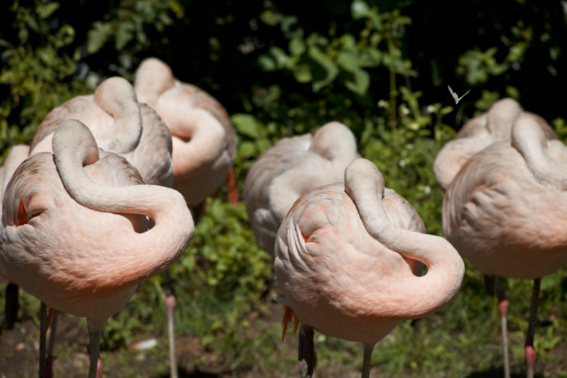
BREAK

Slide 33
CASE Expressions
SELECT (CASE when Amount > 30
THEN Amount ELSE 0 end) FROM Transaction;
SELECT (CASE when Amount > 100 THEN 'Amount=' || Amount ELSE 'MinorAmt' end)
AS FilteredAmount FROM Transaction;
SELECT AVG(CASE WHEN Amount > 90 THEN Amount ELSE NULL end) AS HighAverage,
AVG(CASE WHEN Amount < 90 THEN Amount ELSE NULL end) AS LowAverage FROM Transaction;

Slide 34
Data Cleaning
SELECT StoreID, TransID, NVL(Amount, 0)
FROM Transaction;
SELECT NVL(City, 'N/A'), State
FROM Store;
SELECT NVL(City, State || '-' || StoreID), State
FROM Store;

Slide 35
Iteration Principles
for item in ListOfThings
for i in [1,5,10]:
print "Value of i is ", I
for i in range(12,17):
print " I = ", i
for i in ['Jane', 'Jack', 'Emily']:
print I
for i in 'This is just a string of characters':
print i

Slide 36
Iteration
dict1 = {'Key1':'Value1', 'Key2':'Value2', 'Key3': 'Value3'}
for key in dict1.keys():
print key
for value in dict1.values():
print value
for (key, value) in dict1.items():
print key, '->', value

Slide 37
Array Iteration
arr = numpy.array([[1,2,3],[4,5,6], [7,8,9],[10,11,12]])
for i in arr: print i
for i in range(len(arr)):
print arr[i]
for x, y in numpy.ndindex(arr.shape):
print x, y
for x, y in numpy.ndindex(arr.shape):
print " X ", x, " Y ", arr[x,y]

Slide 38
Reading from the Web
import urllib2
webFD=urllib2.urlopen("http://rasinsrv07.cstcis.cti.depaul.edu/CSC455/tweet_data.txt")
webFD.read(100)
webFD.readline()
webFD.close()

Slide 39
Python Comparison
str1 = 'abc'
str2 = 'abc'
str1 == str2
a = 19992000001
b = 19992000000 + 1
a == b
a is b

Slide 40
Python Comparison
l1 = [1,2,3]
l2 = [1,2,3]
l1 == l2
l1 is l2
id(l1)
id(str1)

Slide 41
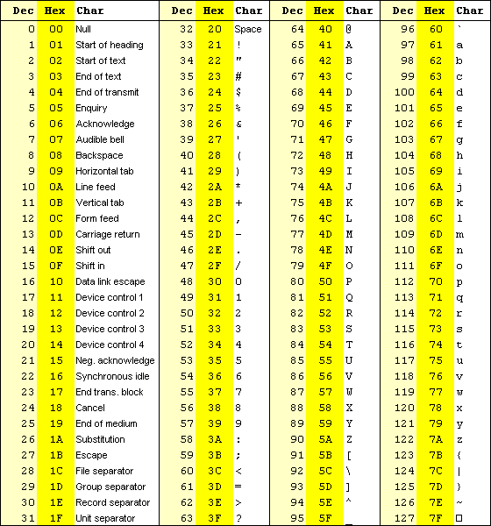


Slide 42
Encoding
Unicode
UTF-8
SELECT * FROM NLS_DATABASE_PARAMETERS WHERE PARAMETER = 'NLS_CHARACTERSET';

Slide 43
Encoding
lines = wfd.readlines()
text = lines[4][106:180]
print text
text[11]
text[12]
text[18]
str1 = 'Escape symbol \\n, \n-\t-‘
print str1
Notes:
wfd = urllib2.urlopen("http://rasinsrv07.cstcis.cti.depaul.edu/CSC455/assignment4.txt")

Slide 44
Functions
def timesTwo(x):
return x*2
def square(x):
return x*x
def applyFunc(func, val):
return func(val)
applyFunc(square, 10)

Slide 45
Lambda
lambda x: x*x # square function
applyFunc(lambda x: x*x, 10)

Slide 46
DataFrames
numpy.arange(40)
numpy.arange(40).reshape((4,10))
numpy.arange(40).reshape((4,10))
frame = pandas.DataFrame(numpy.arange(20).reshape((4,5)), index = ['two', 'one', 'three', 'four'], columns = ['b','a','d','c','f'])

Slide 47
Sort
frame.sort_index()
frame.sort_index(axis = 1)
frame.sort_index(axis = 1, ascending = False)
frame.sort_index(by = 'd', ascending = False)

Slide 48
Reading/Writing Data
pandas.read_csv('text1.txt')
pandas.read_table('text1.txt', sep = ',')
No header
  pandas.read_csv('text2.txt', header=None)
pandas.read_csv('text2.txt', names = ['Trial', 'Mass', 'Velocity'])
Notes:
"trial","mass","velocity"
"A",10,12
"A",11,14
"B",5,8
"B",6,10
"A",10.5,13
"B",7,11

Slide 49
Reading/Writing Data
f1 = pandas.read_csv('text3.txt') # Bad data
pandas.read_csv('text3.txt', skiprows=[1,2])
pandas.isnull(f1)
a = pandas.read_csv('text3.txt', na_values={'Col1':['A']})
pandas.read_csv('text3.txt', nrows = 4)

Slide 50
Reading/Writing Data
frame2 = pandas.read_csv('text2.txt')
frame2.to_csv(sys.stdout, sep='|')
frame2.to_csv(sys.stdout, sep='\t')
frame2.to_csv('out1.txt', sep='_')
pandas.read_csv('out1.txt') # sep = '_'
frame2.to_csv(sys.stdout, header=False, index=False)

Slide 51
JSON Data
webFD=urllib2.urlopen("http://rasinsrv07.cstcis.cti.depaul.edu/CSC455/tweet_data.txt")
tweet = webFD.readline()
json.loads(tweet)
# clean up
tweet = tweet[6:]

Slide 52
Interacting with Databases
c.execute("SELECT * FROM ZooKeeper")
rows = c.execute("SELECT * FROM ZooKeeper").fetchall()
df = pandas.DataFrame(rows)
import pandas.io.sql
pandas.io.sql.read_frame('select * from ZooKeeper', conn)
pandas.io.sql.write_frame(a, 'ZooKeeper2', conn)

Slide 53
Combining/Merging Data
pandas.read_csv('text1.txt')
df2 = pandas.DataFrame({'trial':['A','C'], 'description':['Good trial', 'Bad trial']})
pandas.merge(df1, df2)
pandas.merge(df1, df2, on = 'trial')
pandas.merge(df1, df2, how = 'outer')

Slide 54
Combining/Merging Data
df3 = pandas.DataFrame({'Test':['A','C', 'B'], 'description':['Good trial','Bad trial', 'Unknown Trial']})
pandas.merge(df1, df3, left_on='trial', right_on = 'Test')
df4 = pandas.DataFrame({'Test':['A','A', 'A'], 'description':['Good trial', 'Bad trial', 'Unknown Trial']})

Slide 55
Transforming Data
array1 = numpy.arange(12).reshape(4,3)
numpy.concatenate([array1, array1])
numpy.concatenate([array1, array1], axis = 1)
s1 = pandas.Series([0,1], index=['a', 'b'])
s2 = pandas.Series([2,3,4], index=['c', 'd', 'e'])
s3 = pandas.Series([5,6], index=['f', 'g'])
pandas.concat([s1,s2,s3])
s4 = pandas.Series([7,8], index=['g', 'h'])
pandas.concat([s1,s2,s3,s4], axis = 1)

Slide 56
Transforming Data
pandas.concat([s1,s2,s3], keys=['1st', '2nd', '3rd'])
pandas.concat([s1,s2,s3,s4], keys=['1st', '2nd', '3rd','4th'], axis =1 )

Slide 57
Transforming Data
dfc = pandas.DataFrame(df1['trial'])
dfc.duplicated()
dfc.drop_duplicates()
df1.duplicated(['trial'])
df1.drop_duplicates(['trial'], take_last=True)

Slide 58
Transforming Data
mapping={'A':'Trial-A', 'B': 'Trial-B'}
df1['trial'].map(mapping)
df1['trial'] = df1['trial'].map(mapping).map(str.upper)
df1 = pandas.read_csv('text1.txt')
df1['trial'].map(lambda x: mapping[x])
df1['trial'].map(lambda x: "-"+mapping[x]+"-")

Slide 59
Regular Expressions
import re
regex1 = re.compile('created_at')
regex1.findall(tweet)
regex2 = re.compile('created_at":"[^"]*"')
regex2.findall(tweet)
regex3 = re.compile('"\w+":"[^"]*"')
regex4 = re.compile('"\w+":null')

Slide 60
Next Time:
Python
  Chapter8, Chapter9
Visualizing data
Aggregation
Database tuning
Read Chapter 6, Chapter 7
(Assignment 5 posted by tomorrow)

